Slide 1
New Evidence on Performance of California Partnership Academies
David Stern
Graduate School of Education
University of California, Berkeley
College & Career Academy Support Network
http://casn.berkeley.edu
Prepared for presentation to Educating for Careers conference
Sacramento
March 4, 2014

Slide 2

Overview
Three main questions
New evidence from California
Profiling individual academies

Slide 3
Three main questions
Who enrolls? Do academy students represent a cross-section of the school?
Who stays? Are some groups of students more likely to leave the academy?
Who improves? Does academy students’ performance improve more than non-academy students’?

Slide 4
Who enrolls?
In 2009-10, 10th graders in California Partnership Academies were more likely than non-academy 10th graders to:
Be eligible for subsidized lunch
Have parents with less education
Be Latino or African American

Slide 8

But there’s a lot of variation among academies.
Some academies
under-represent
students in these
groups.

Slide 9
Number of academies in which the proportion of grade 10 students who were eligible for subsidized lunch was higher, not significantly different, or lower than among grade 10 non-academy students at the same school
35 academies

Slide 10
Number of academies in which grade 10 students had parents with higher, not significantly different, or lower levels of education compared to grade 10 non-academy students at the same school

Slide 11
Number of academies in which the proportion of grade 10 students who were Latino was higher, not significantly different, or lower than among grade 10 non-academy students at the same school

Slide 12
Number of academies in which the proportion of grade 10 students who were African American was higher, not significantly different, or lower than among grade 10 non-academy students at the same school

Slide 13
Who stays?
We traced two cohorts of academy students from grade 10 through graduation.
Cohort 1 enrolled in grade 10 in 2008-2009.
Cohort 2 enrolled in grade 10 in 2009-2010.

Slide 14
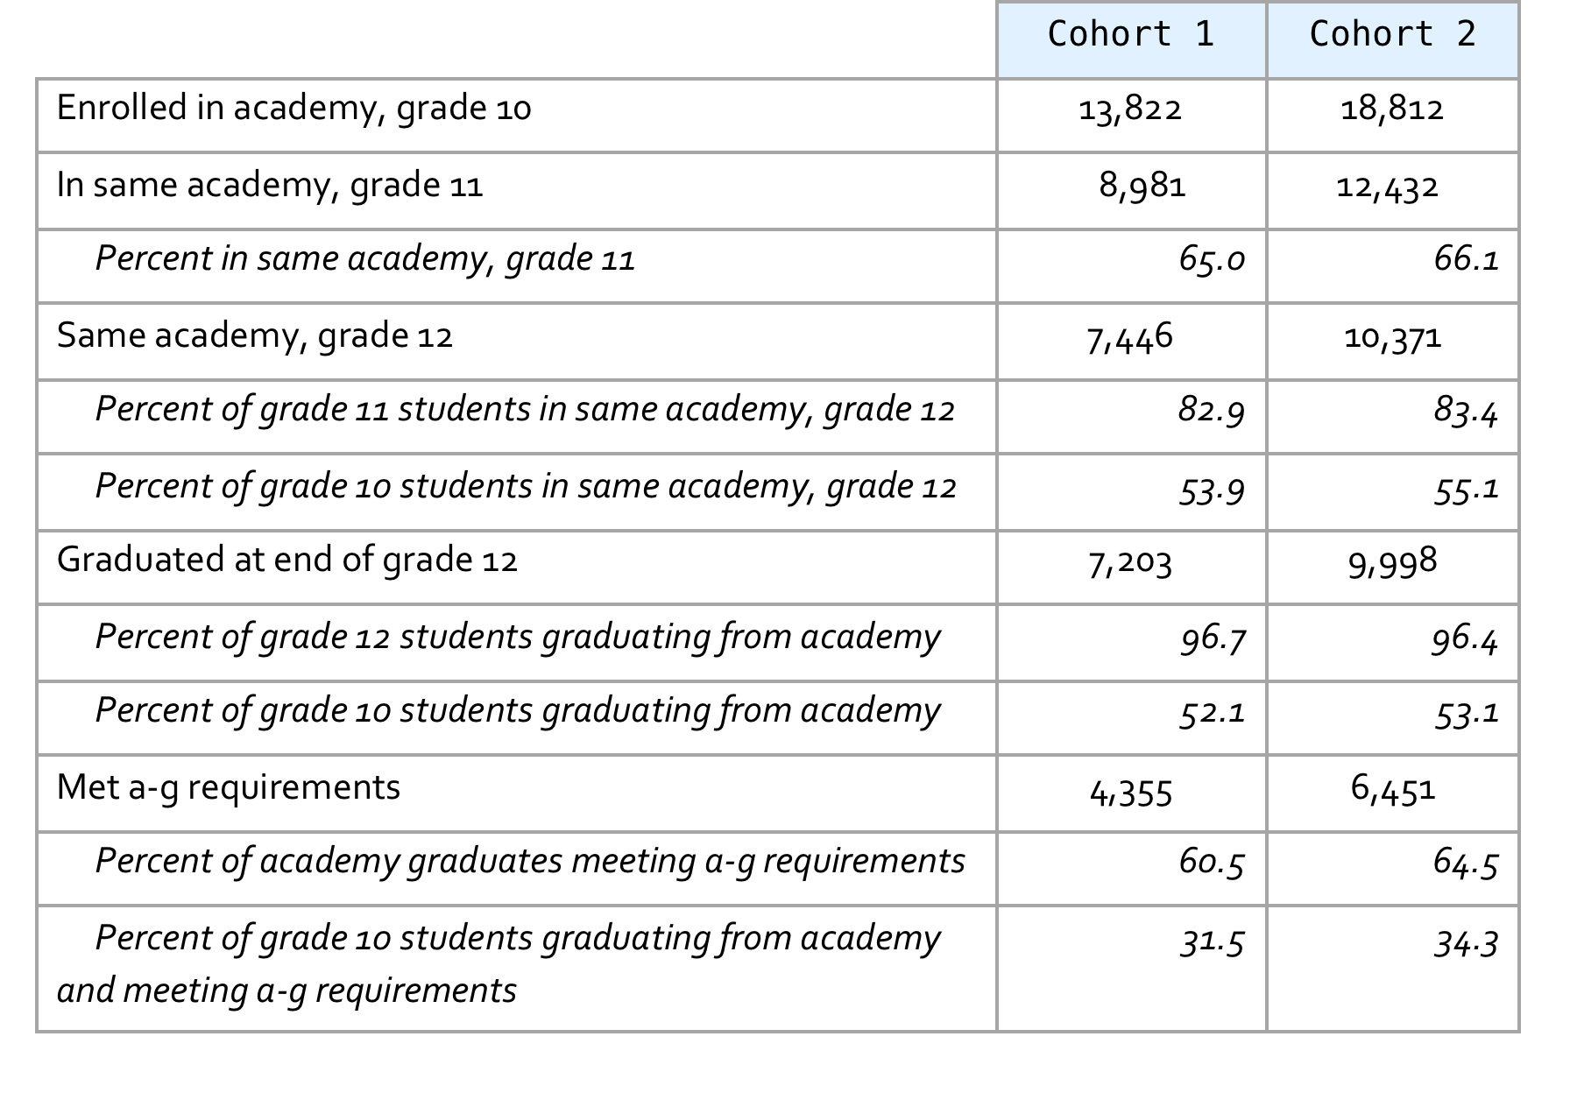
Summary of promotion, graduation and a-g course completion rates

Slide 15
About one-third of 10th graders leave their academies after one year.
Most of these stay at the same high school, and almost all stay enrolled in a California public school.
But there’s a lot of variation among academies.

Slide 16
Distribution of academies by percentage of 2008-09 10th graders who enrolled in same academy as 11th graders in 2009-10 (cohort 1)

Slide 17
Distribution of academies by percentage of 2009-10 10th graders who enrolled in same academy as 11th graders in 2010-11 (cohort 2)
About 65 academies lost more than half their 10th graders in cohort 2

Slide 18
Who stays: 10th graders by at-risk designation, cohort 1

Slide 19
Who stays: 10th graders by at-risk designation, cohort 2

Slide 20
Who improves?
Compared to state as a whole in 2004-2005 and again in 2009-2010:
academy seniors had higher graduation rates, and
academy graduates were more likely to complete a-g courses required for admission to public university.

Slide 21
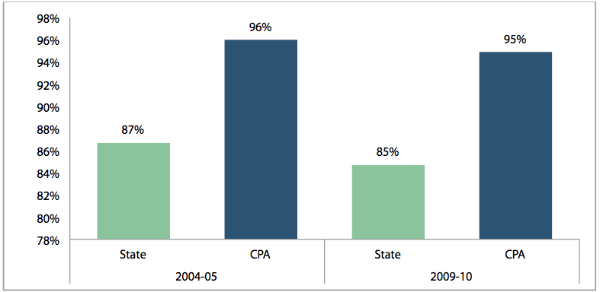
CPA and California
12th-grade graduation rates,
2004-05 and 2009-10

Slide 22
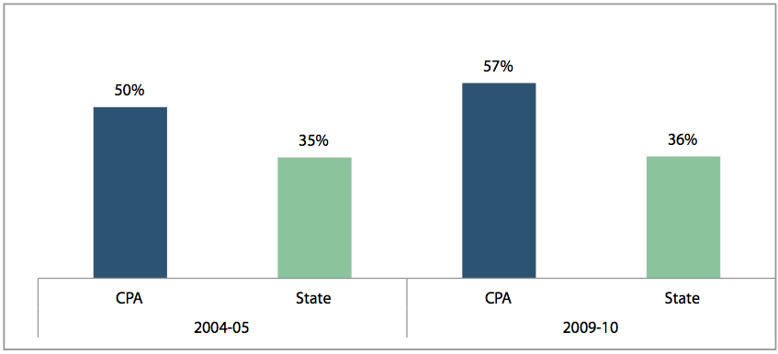
CPA and California
graduates completing a-g requirements,
2004-05 and 2009-10

Slide 23

But again there is variation among academies, especially
in a-g completion
rates.
Apparently some academies emphasize
a-g courses more than others.

Slide 24
Distribution of academies by percentage of spring 2011 graduates who completed a-g course requirements (cohort 1)

Slide 25
Distribution of academies by percentage of spring 2012 graduates who completed a-g course requirements (cohort 2)

Slide 26
Who improves: attendance, credits, grades, and test scores
On average, year-to-year changes in academy students’ attendance, credits, and grades were very small.
Changes in test scores don’t differ consistently between academy and non-academy students in the same schools.
But again there are big differences among academies!
Notes:
Source: Profile of California Partnership Academies 2009-10, at http://casn.berkeley.edu

Slide 27
All this information can be combined into a profile for each academy each year.
This can help
identify effective practices,
and where improvements are needed.

Slide 28

